Slide 1
HOW
STUDENT-CREATED VIDEOS KILLED
MONOTONY IN MY CLASS
Romi Češčut

Slide 2
Content
INTEGRATING VIDEOS IN LESSONS – HOW?
2 USES OF STUDENT-CREATED VIDEOS
BENEFITS
Survey
go to menti.com
type in the code 7101 2966
Be active

Slide 3
HOW TO INTEGRATE STUDENT-CREATED VIDEOS IN LESSONS – theoretical premises
Purpose
Context
Reward
Enhance educational process
Avoid overuse
CLIL/ English for specific purposes

Slide 4
HOW TO INTEGRATE STUDENT-CREATED VIDEOS IN LESSONS – practical ideas, advice
Timelining
Content
Assessment criteria
Clear instructions
Choice of apps?
Peer feedback
Activities before and after?

Slide 5
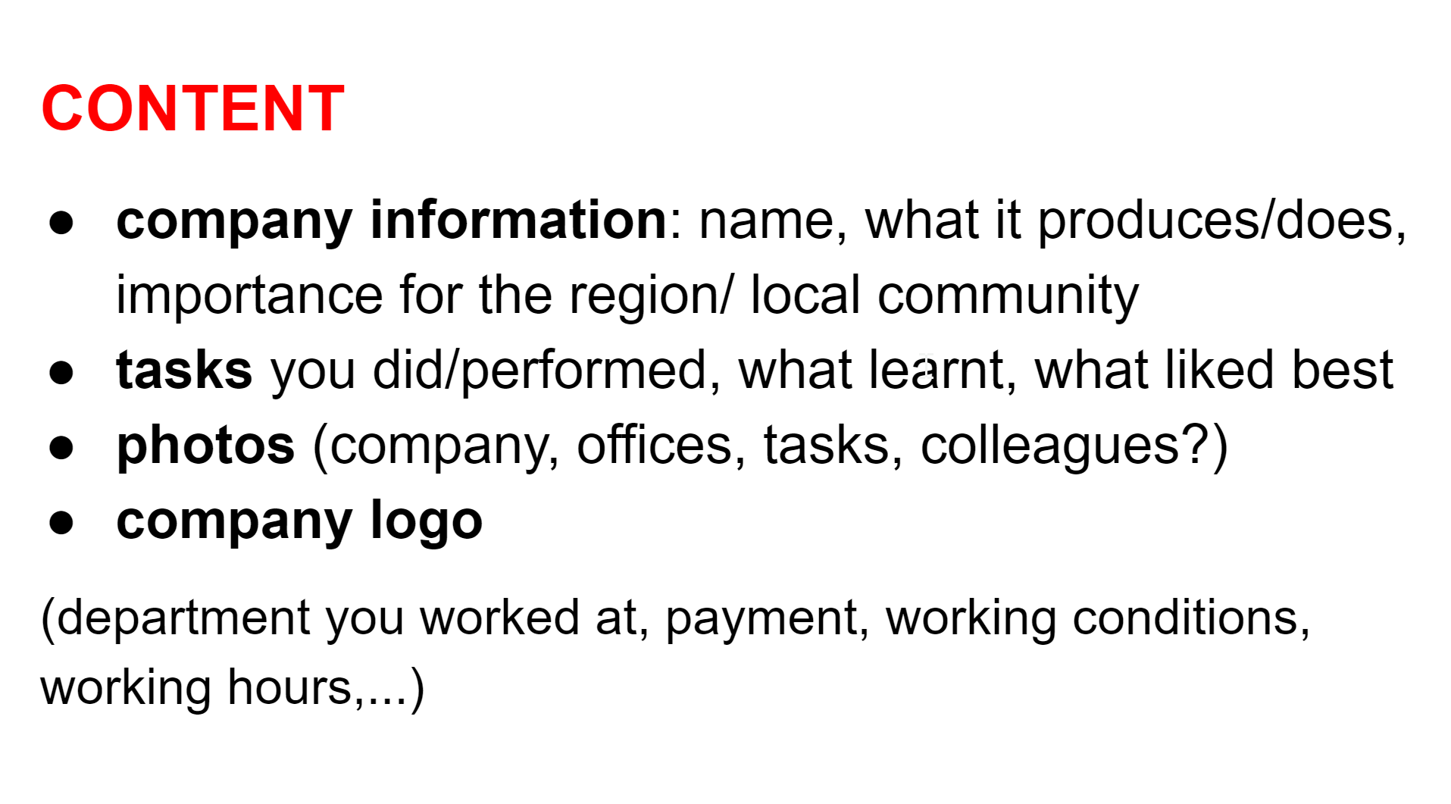
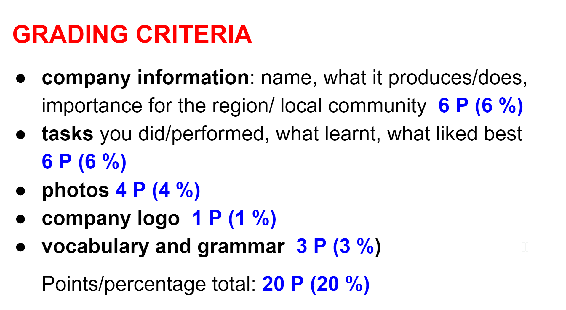
USE 1: INTERNSHIP VIDEO REPORT
Spring 2021 – electrical engineering students
Fall 2022 – computer science students
Content elements, form, assessment criteria, feedback, reward

Slide 6
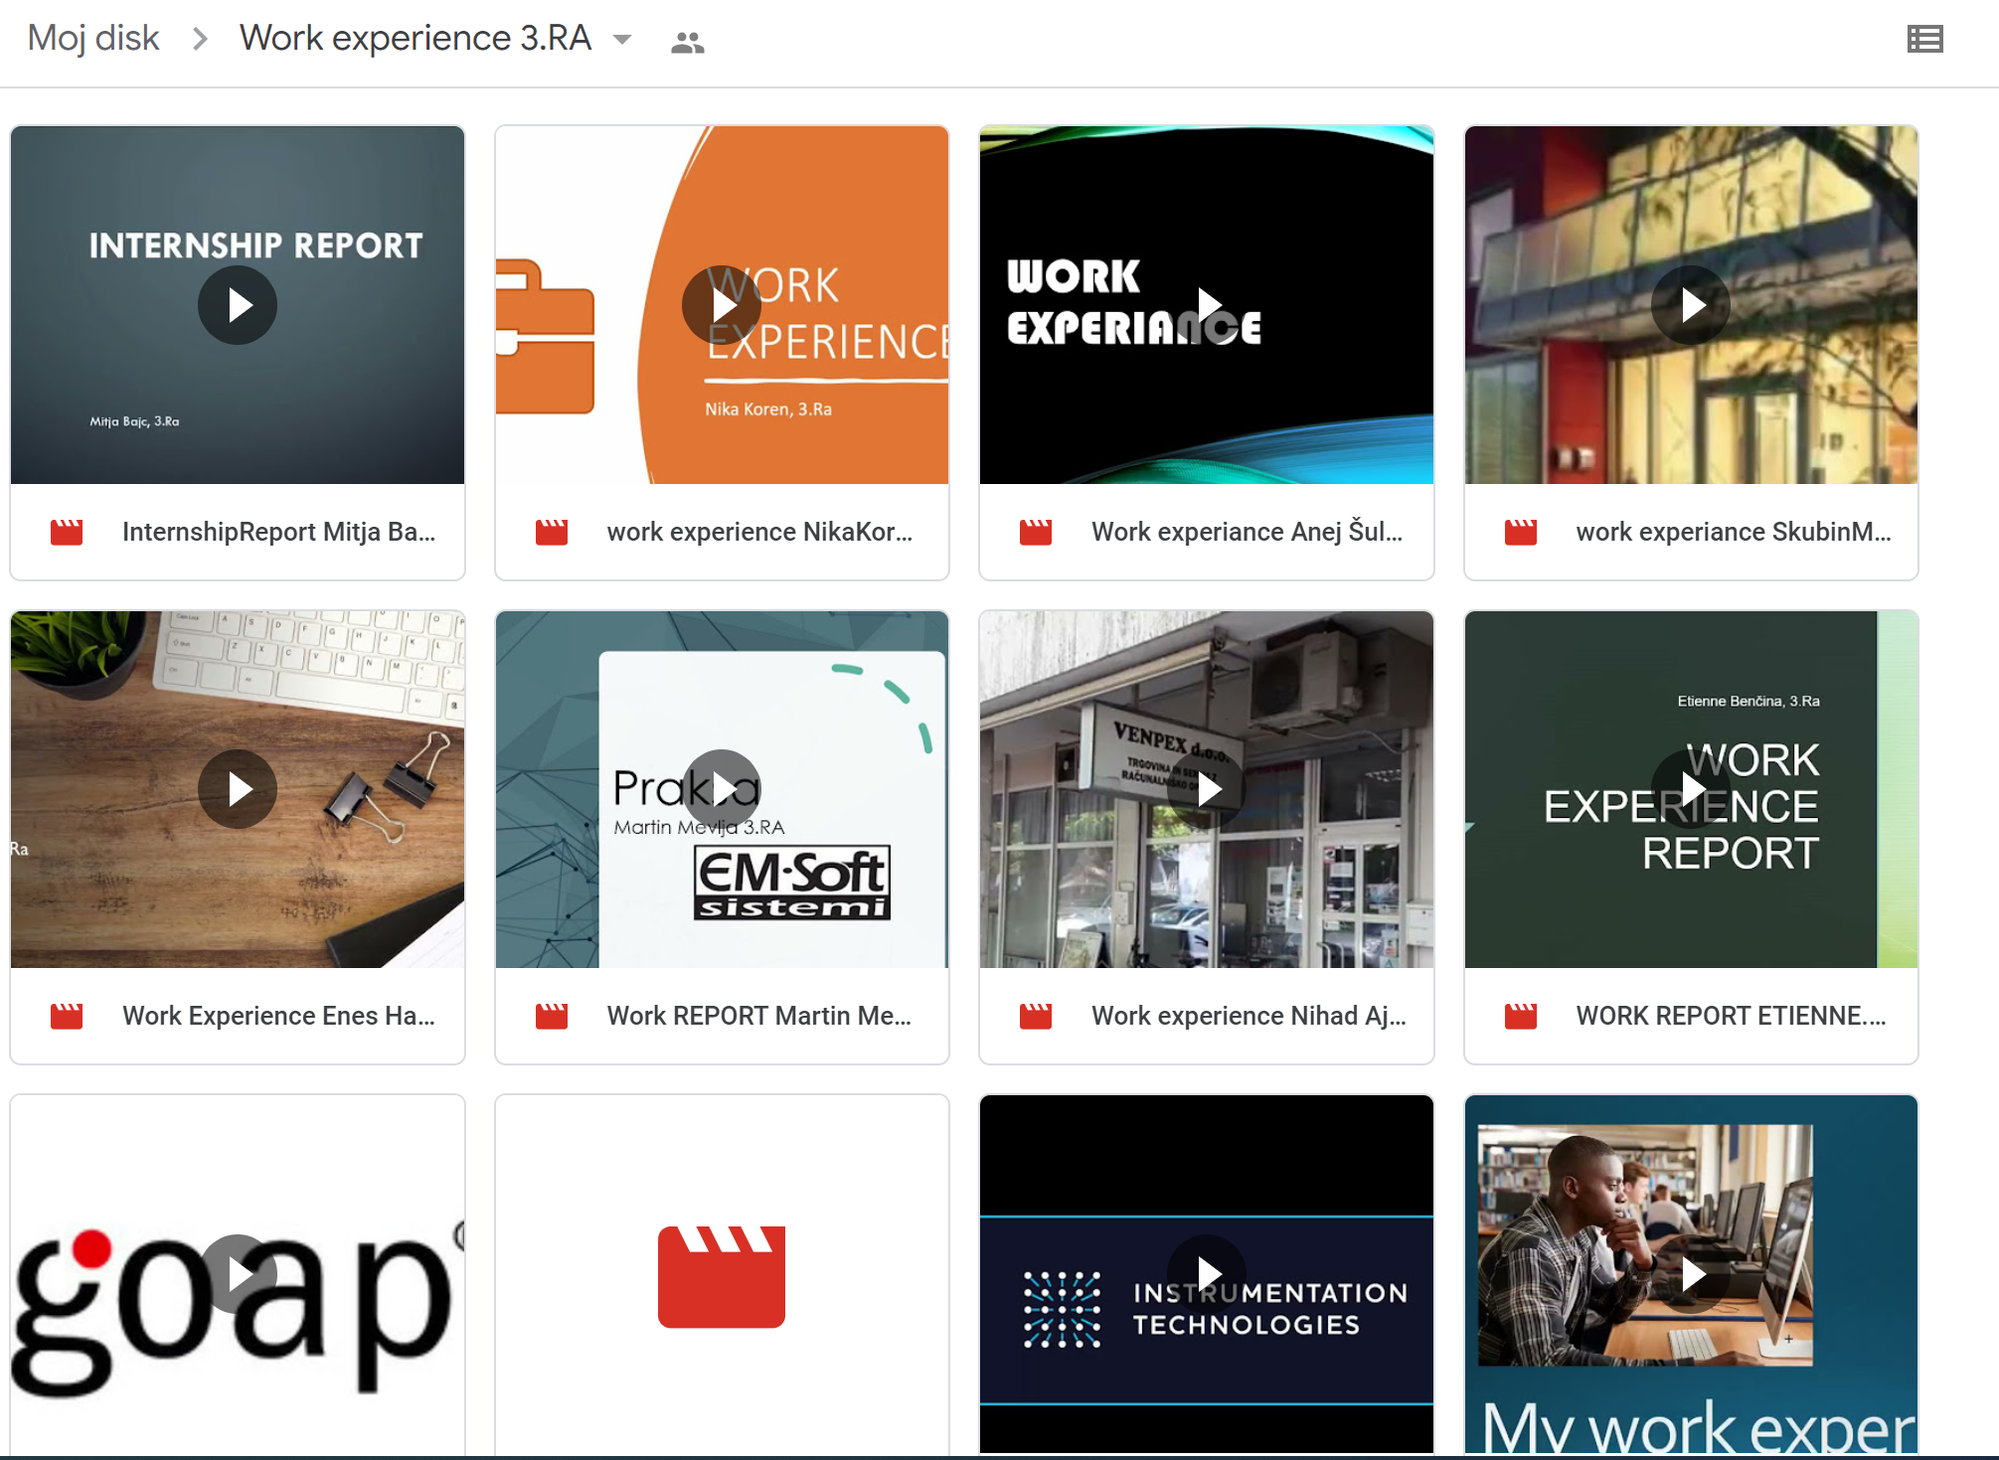

Slide 7
INTERNSHIP VIDEO REPORT
Video
Assess the content
go to menti.com
type in the code 7851 3406
Be active

Slide 8
INTERNSHIP VIDEO REPORT
Weak students
Field-based vocab
Technology
Sociological aspects

Slide 9
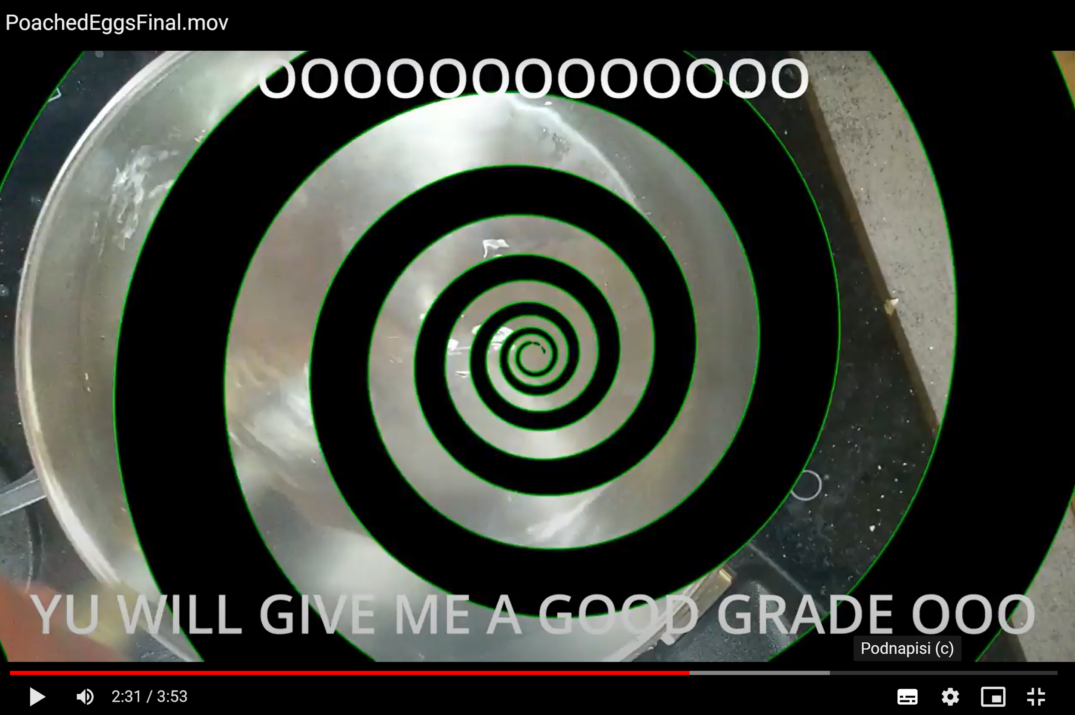
USE 2: VIDEO RECIPE
Purpose, final-grade students
Content elements, form, assessment criteria, feedback, reward
Humor, creativity

Slide 10
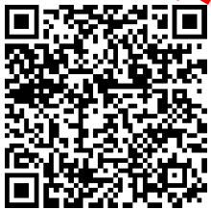
VIDEO RECIPE
After-watching activities: interview with the author, debate, ethnographic aspects
2 Exercises in a Google form:
Scan the code, complete the form
Watch the video recipe and check your answers.
Be active

Slide 11
VIDEO RECIPE
Revision of vocab, grammar, functions
Weak students
Creativity
Digital literacy skills
Enthusiasm and challenge
Bad news: there is a !

Slide 12
INSTEAD OF A CONCLUSION
Purpose
vocab and function practice, sociological
aspects, humor, creativity & imagionation
CLIL/English for specific purposes, final examination?
Digital literacy skills: creating, sharing digital content
Performance skills, collaborative learning
Entertainment + learning

Slide 13
Questions, comments, experience?
Thank you for listening.
Be active
? Questions, comments, experience sharing ?

