Slide 1
CLIL method implementation
by Ana Kodrić Ivelić

Slide 2
CONTENT LANGUAGE INTEGRATED LEARNING
Since 1994 by David Marsh
“A method where a foreign language is used as a tool in the learning of a non-language subject in which both language and the subject have a joint role.”

Slide 3
CLIL PRINCIPLES
Language is used to LEARN as well as to COMMUNICATE
Acquire knowledge and skills using target language
Language and the subject matter are equally important
Develop cognitive (thinking) and social skills
Project teamwork skills – modern world, IT skills, linguistic and intercultural, whole life learning

Slide 4
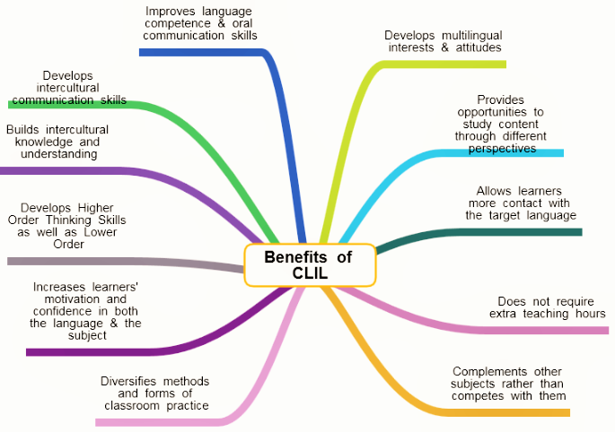
benefits of clil www.languages.dk

Slide 5
DIFFICULTIES
1. Cooperation for programme consolidation
2. Subject teacher should speak the target language well and a language teacher should know the subject matter well.
3. New concepts - difficult to accept
4. Shortage of materials
5. Time consuming

Slide 6
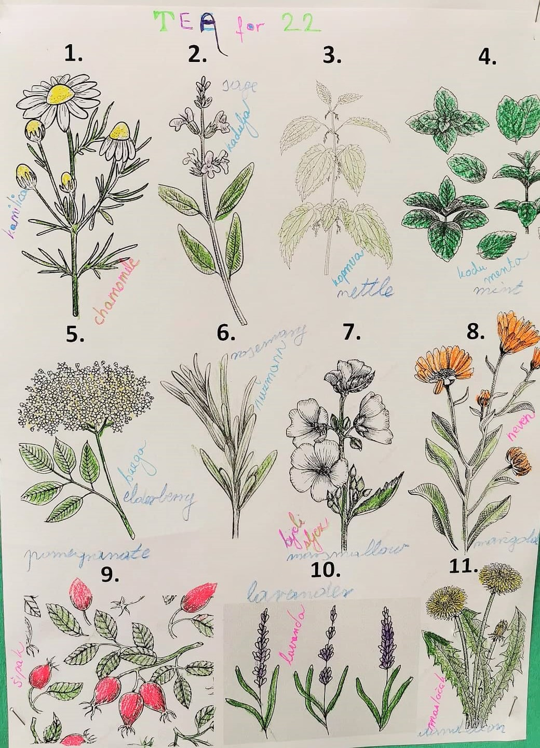
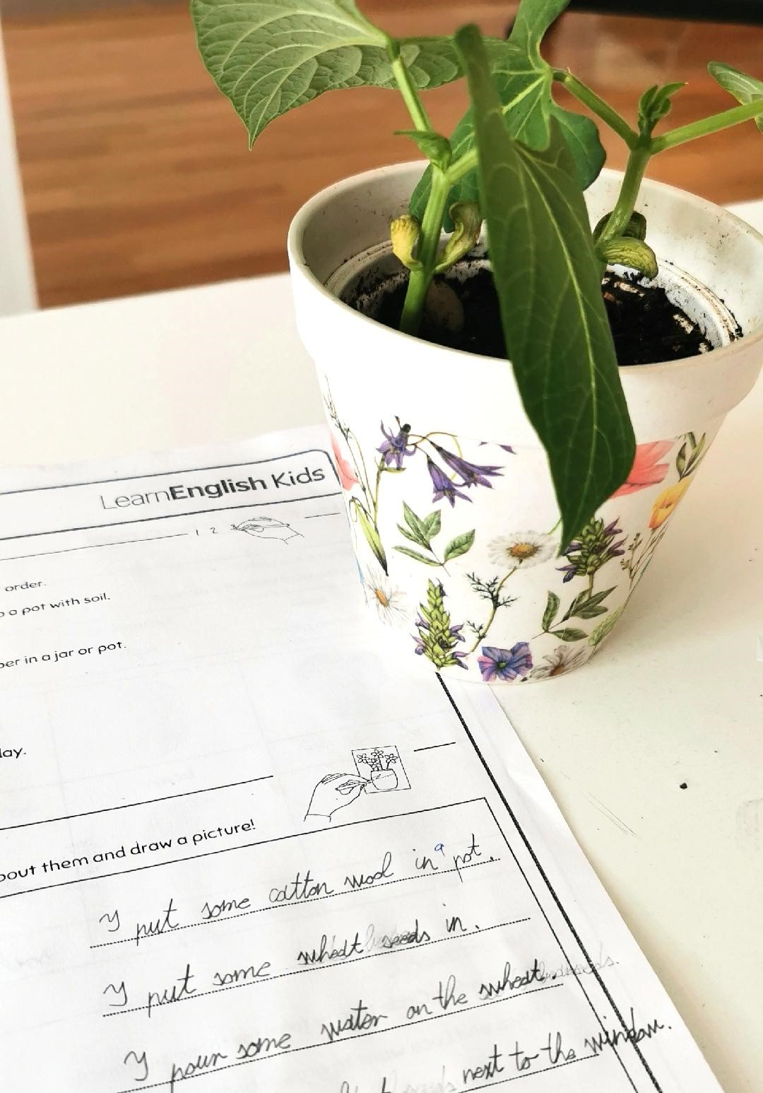
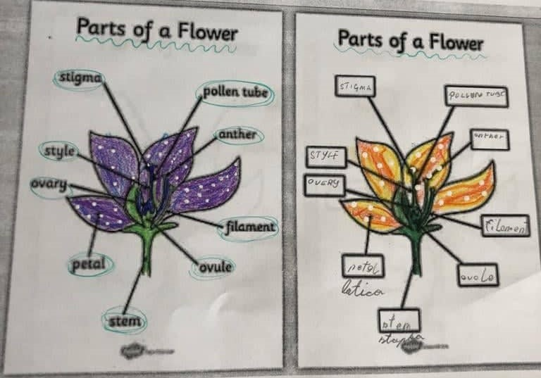
CLIL in elementary school Pujanki
Erasmus+ KA1 project
“CLIL I Will” 2020.
6 teachers
8 mobilities
96/100 points ☺
Maths, Science, Biology, Chemistry, PE, Art

Slide 7
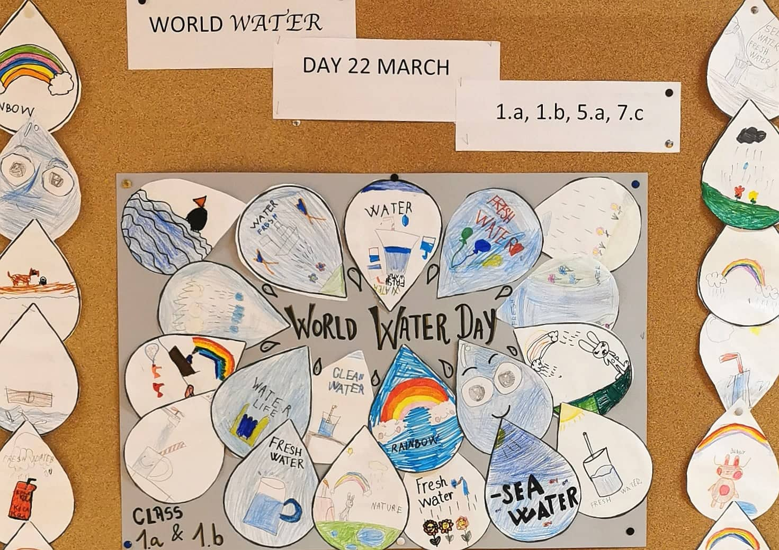
1st grade
Water cycle
Science, Art, Civil Ed.

Slide 8
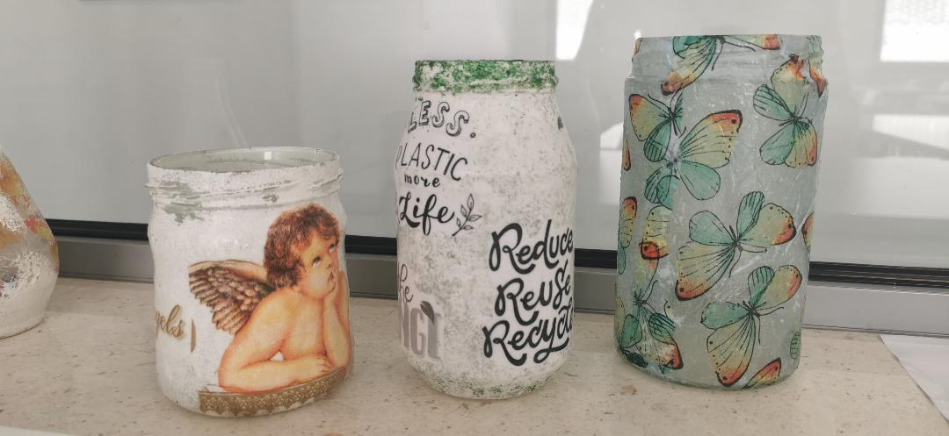
School CLIL project:
Chemistry / Art / Citizenship
Carbon cycle
Global warming
3Rs - link

Slide 9
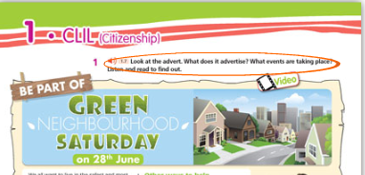
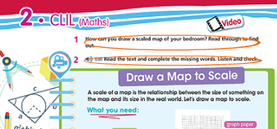
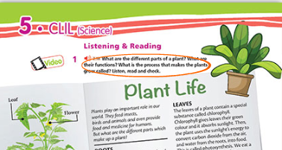
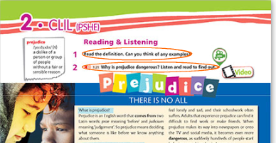
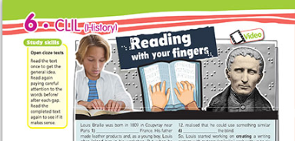
Course book material ☺

Slide 10
WORKSHOP CLIL lesson framework a successful CLIL lesson includes 4C
CONTENT
The skills and knowledge related to a specific subject matter (scaffolding)
COMMUNICATION
Using language to learn and learning to use the language (vocabulary, phrases, grammar, scaffolding)
COGNITION
Developing thinking skills which link concept formation, understanding and language (activities, tasks)
CULTURE
Exposure to alternative perspective, intercultural. Real life xamples

Slide 11
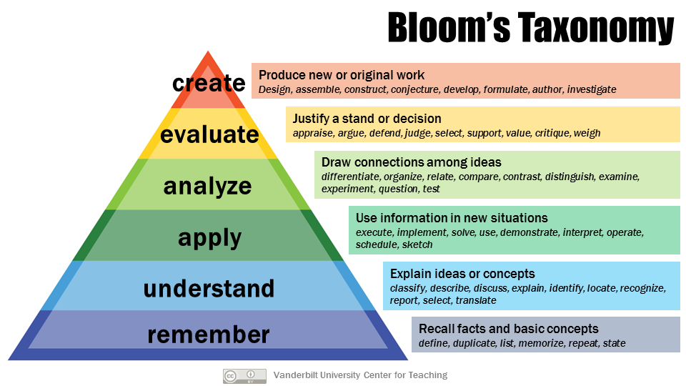
Bloom’s Taxonomy - classifies learning objectives
Lower Order Thinking Skills - LOTS
Higher Order Thinking Skills - HOTS
Levels increasing in complexity from the base up to the triangle’s peak.
We should take Bloom’s Taxonomy into consideration while task creating.

Slide 12
ACTIVITY IDEA 1 ask questıons using bloom’s taxonomy

Slide 13
ACTIVITY IDEA 2 Ask 2 lots and hots questions

Slide 14
While planning CLIL lessons and activities always take into consideration the 4Cs.
CONTENT - the topics and objectives of the lesson
COMMUNICATION - target vocabulary and structures, functional language
COGNITION - critical thinking, creative thinking, Bloom’s Taxonomy (Lots and Hots)
CULTURE - knowledge being related to students real life
+ ASSESSMENT

Slide 15
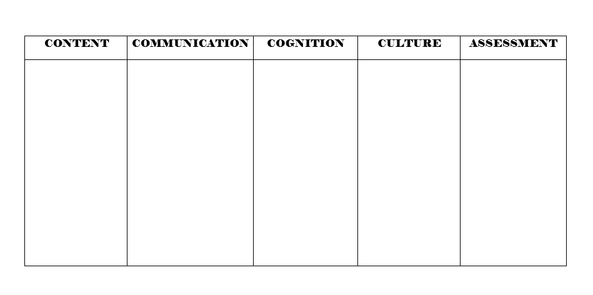
Task: THE SENSES sight, hearing, smell, taste, touch
Chart by A.Kodrić Ivelić

